Slide 1
DLR.de • Chart <number>
Moritz Zeumer • 14.06.2021
Motion Sickness Reduction for 6-DoF-Navigation in a Virtual Solar System
Notes:
- overview of CSVR
.
- overview of cybersickness sources and mitigation
.
- scope of the thesis
.
- floor grid
.
- FoV vignette
.
- automatic movement overhaul
.
- user study

Slide 2
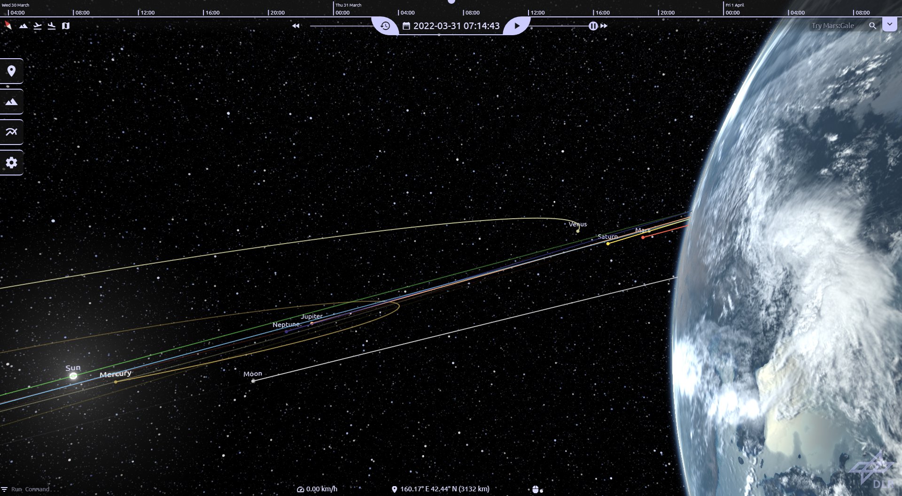
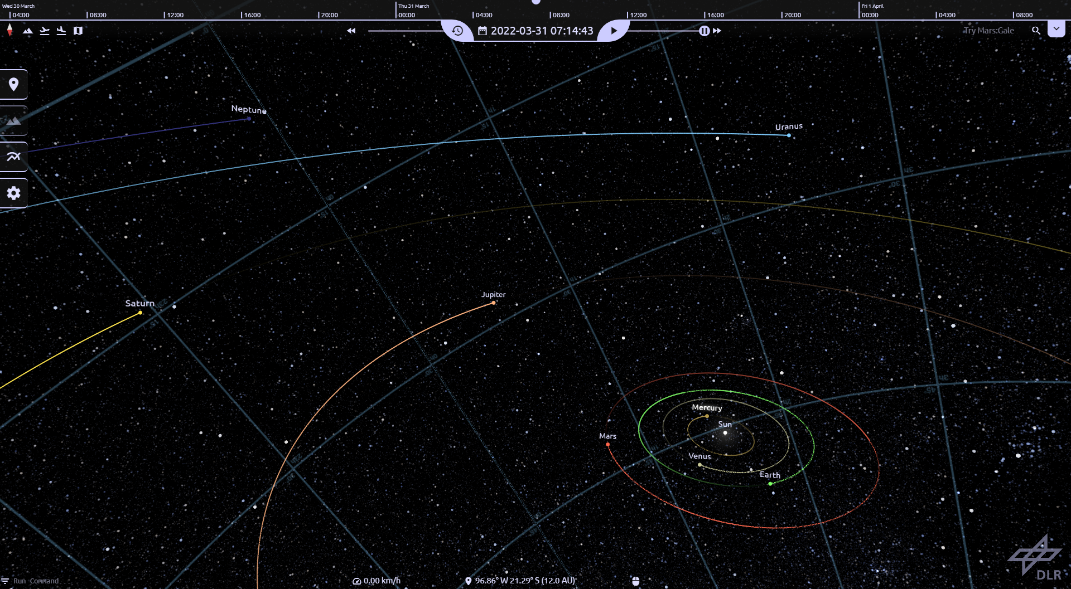
DLR.de • Chart <number>
Moritz Zeumer • 14.06.2021
What is CosmoScout VR?
Modular, scientific, 3D visualisation of the Solar System
High resolution elevation models and satellite imagery
Interactive and immersive exploration of large datasets at diverse scales
Modular, layered architecture to provide high-flexibility for different user cases
Notes:
(1) Modular, scientific, 3D visualisation of the Solar System
.
(2) High resolution elevation models and satellite imagery
- international community has produced vast amounts of data
.
(3) Interactive and immersive exploration of large datasets at diverse scales
.
(4) Modular, layered architecture to provide high-flexibility for different user cases

Slide 3
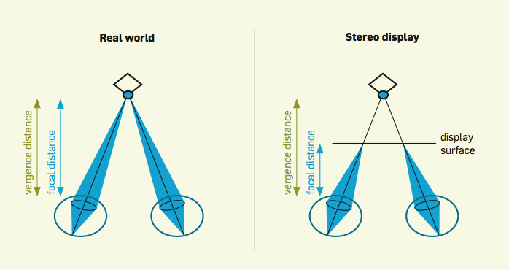
DLR.de • Chart <number>
Moritz Zeumer • 14.06.2021
What Causes Cybersickness?
Sensory Conflict Theory
  Sensory mismatch between sensory systems of the body (visual ↔ somatosensory / vestibular system) ¹
  Conflicts due to vection (illusion of self movement while stationary) ²
Postural Instability Theory
  Uncontrolled movements and changes to the center of gravity → inability to maintain postural stability ³
  Postural instability i.e., lateral-medial body sway often precedes experiences of motion sickness ⁴
Vergence-Accommodation Conflict Theory
  Vergence (lateral eye movement adjusting to objects at different distances)
  and Accomodation (adjusting eye’s focal length to focus on the objects)
  occur at different distances ⁵
1: Barrett, G. V. and C. L. Thornton: Relationship between perceptual style and simulator sickness.
2: Keshavarz, B., et al.: The effect of visual motion stimulus characteristics on vection and visually induced motion sickness.
3: Riccio, G. E. and T. A. Stoffregen: An ecological theory of motion sickness and postural instability.
4: Stoffregen, T. A. and L. J. Smart: Postural instability precedes motion sickness.
5: Kim, J., et al.: The rate of change of vergence–accommodation conflict affects visual discomfort.
6: Kroeker K. L.: Looking beyond stereoscopic 3D's revival.
Vergence-Accommodation Conflict in Stereoscopic Displays ⁶
Notes:
(1) Sensory Conflict Theory
- Information from senses does not match each other or expectation
- somatosensory => self-movement & body position
- vection => illusion of self movement (visual information does not match somatosensory haptic perception, spacial position and movement relative to support surface and each other)
.
(2) Postural Instability Theory
- uncontrolled small movements like natural body sway
- usually happens before motion sickness
- naturally unstable people may be at a higher risk to show symptoms
- Rest Frame Theory → instability from confusing reference frames not coinciding with gravity gradient
.
(3) Vergence-Accommodation Conflict Theory
- vergence => lateral eye movement adjusting to objects moving towards and away from the observer
- accommodation => adjusting the eye’s focal length to focus on the object
- happens at different distances in stereoscopic displays → causes eye strain resulting in cybersickness
- highly active content with different stimulus distances worsen the problem
- Hardware problem difficult to fix/prevent on a software basis

Slide 4
DLR.de • Chart <number>
Moritz Zeumer • 14.06.2021
How to Prevent Cybersickness?
Best Practices
Limit exposure times and allow adaptation to the virtual environment ¹
Avoid high rates of linear or rotational acceleration, or extraordinary maneuvers ¹
Field of View Limitations
Vection comes from peripheral visual field and is therefore strongly tied to FoV size ²
Reducing the FoV results in less vection and reduced presence, leading to less cybersickness symptoms ³
Stable Reference Frames
Provide stable frames of reference to reduce sensory conflicts and improve postural stability ⁴
1: McCauley, M. E. and T. J. Sharkey: Cybersickness: Perception of self-motion in virtual environments.
2: Duh, H. B. L., et al.: Effects of field of view on balance in an immersive environment.
3: Lin, J. J. W., et al.: Effects of field of view on presence, enjoyment, memory, and simulator sickness in a virtual environment.
4: Chang, E., et al.: Effects of rest frames on cybersickness and oscillatory brain activity.
Notes:
(1) Best Practices
- limit exposure times & provide adaptation phase
- avoid high linear or rotational acceleration & extraordinary/unrealistic (abrupt) maneuvers
- warn users of potential lingering effects after exposure
.
(2) Field of View Limitations
- vection strongly tied to peripheral visual flow → decrease FoV to decrease vection
- lower limit ~60° (becomes too noticeable); upper limit ~120-150° (interval of significant sickness increase in studies)
.
(3) Stable Reference Frames
- stable reference frame to reduce sensory conflicts and improve postural stability
- display grids over the scene / pseudo-AR mode to provide stability at the cost of presence/immersion

Slide 5

DLR.de • Chart <number>
Moritz Zeumer • 14.06.2021
What is Part of the Thesis?
6 DoF navigation control scheme with VR remote lead to complex rotations in free movement
  Reduce cybersickness in interplanetary space and close to, or on body surfaces
Automatic navigation uses simultaneous translation and rotation during travel path
  Overhaul automatic navigation system to provide general, more predictable movements
Design user study to measure user satisfaction and cybersickness symptoms
Notes:
(1) 6-DoF-movement
- free interplanetary movement
- free surface movement
- different features due to different sources for cybersickness
.
(2) Automatic Navigation System
- old navigation uses simultaneous translation and rotation
- overhaul to provide general, predictable movements & separate rotation and translation
(3) User Study Design
- prepare study to measure user satisfaction & cybersickness for the developed features

Slide 6
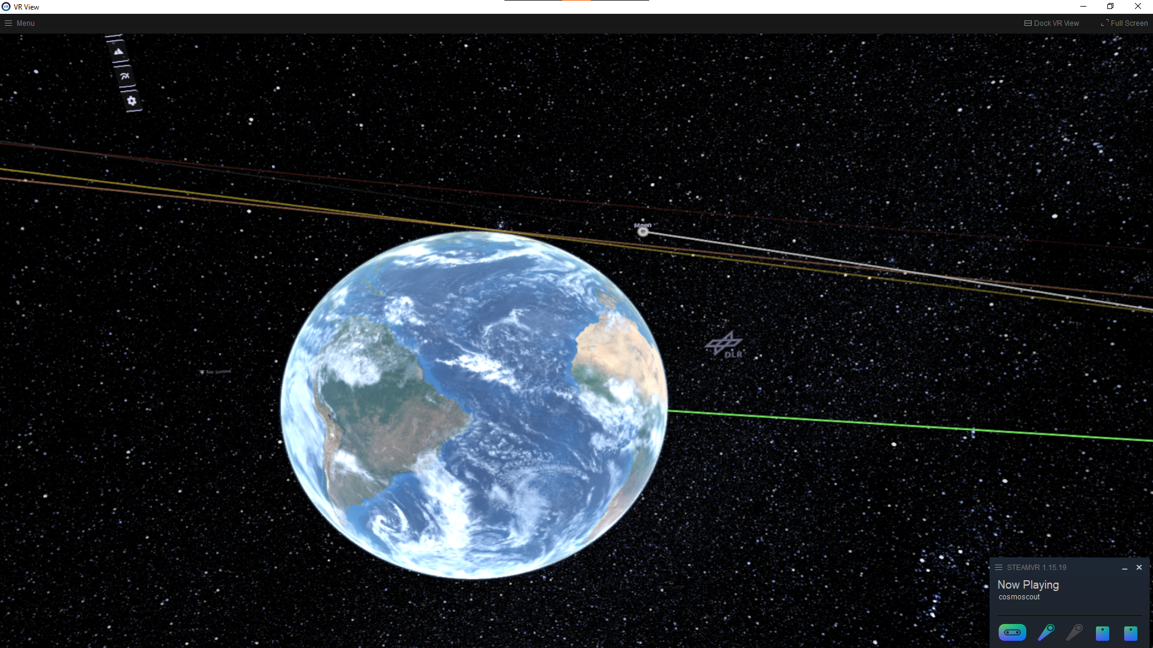
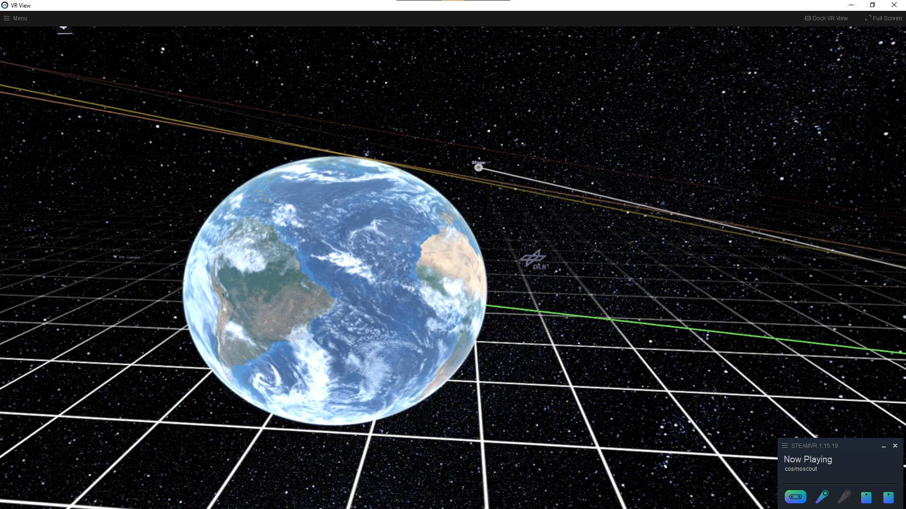
DLR.de • Chart <number>
Moritz Zeumer • 14.06.2021
How To Mitigate The Problems? - Floor Grid
Provides a stable simulated frame of reference during interplanetary free and automatic navigation
  Assist with postural stability and sensory conflicts
Change interaction context from egocentric to exocentric
  Mitigates sensory conflict problems because VR orientation mirrors real-world situation
Notes:
(1) Images Floor Grid On/Off
.
(2) provide stable frame of reference for interplanetary movements
- help maintain postural stability during complex movements(rotation) → postural instability theory
.
(3) change interaction context to fixed user w/ simulation moving around them (exocentric)
- stationary user → reduced sensory conflict
- may require additional changes to control scheme (not part of the project)

Slide 7
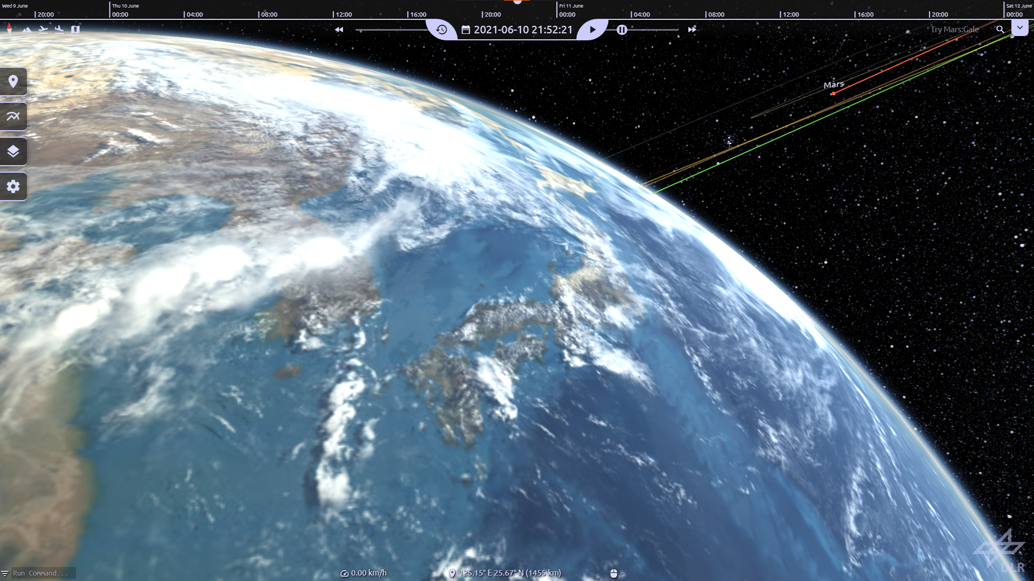
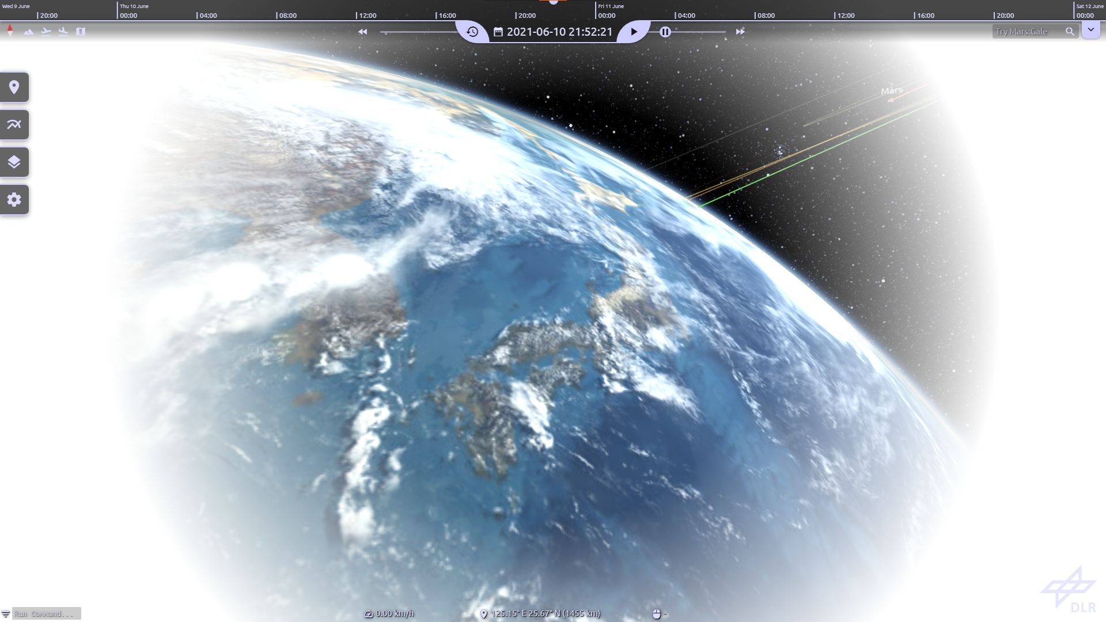
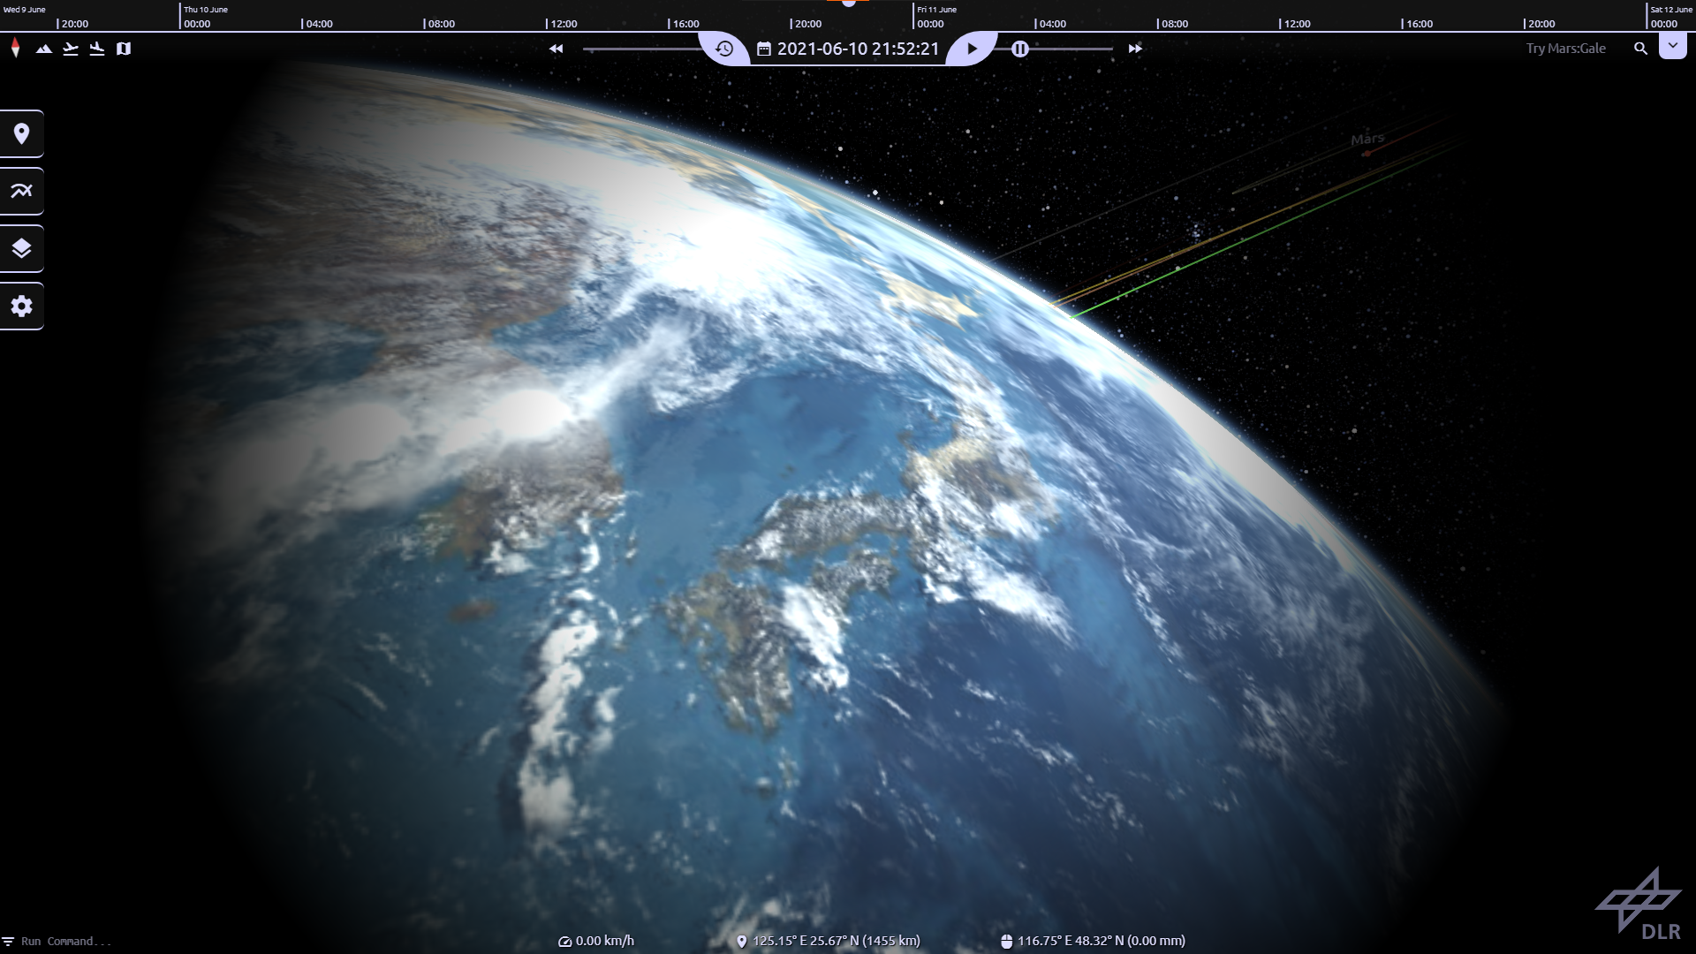
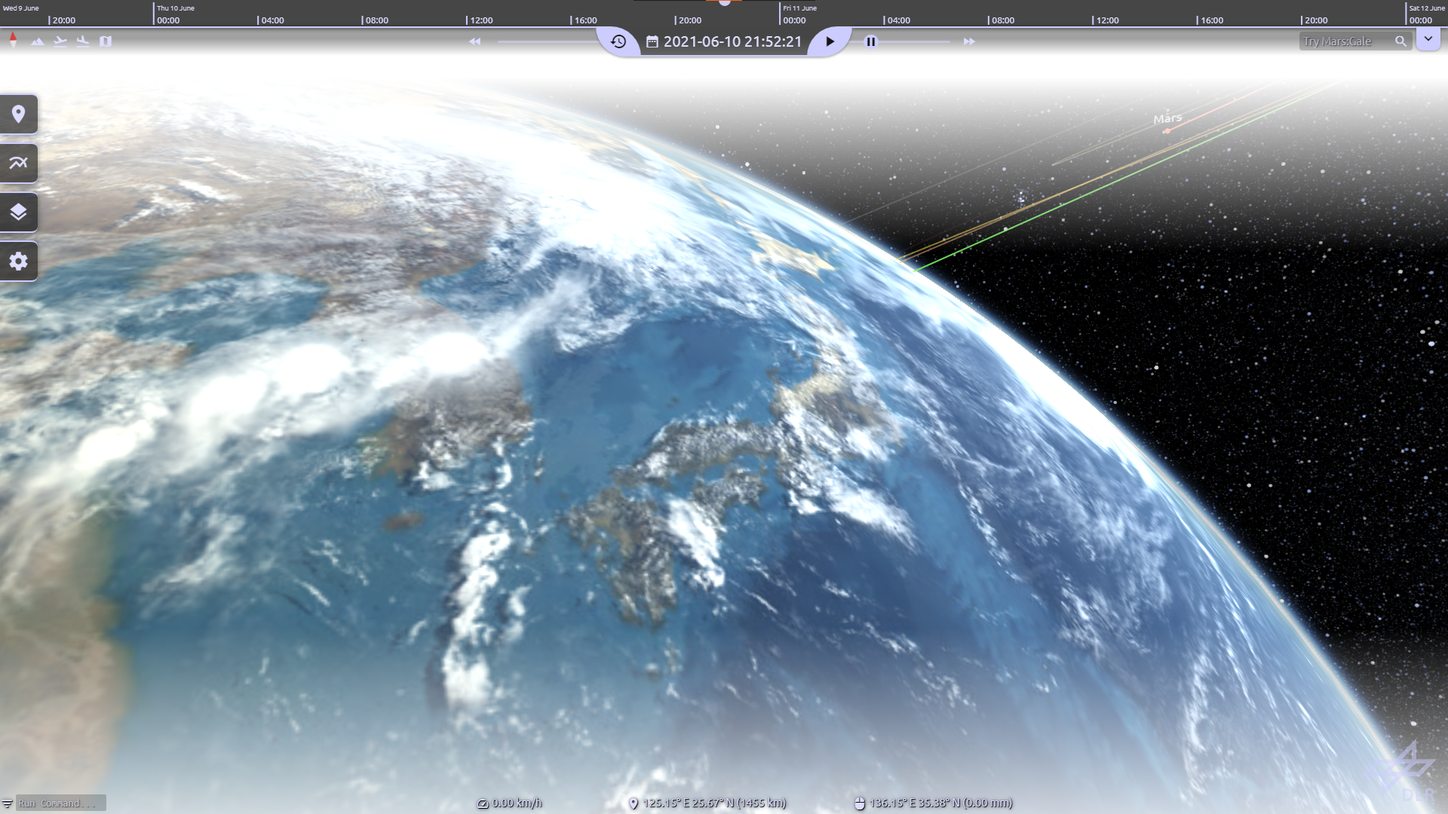
DLR.de • Chart <number>
Moritz Zeumer • 14.06.2021
How To Mitigate The Problems? - FoV Vignette
Popular method of cybersickness reduction
  Applications with high detail and/or movement in peripheral areas of vision
User tends to react to High peripheral detail / movement by moving their eyes instead of their head
  Employ vignette to limit users FoV, focusing on the center of HMD lenses
Notes:
(1) FoV Vignette images (Off/Circular white/Circular black/Vertical white)
.
(2) popular & proven method of sickness mitigation
- especially for application with high detail/movement (in peripheral vision)
.
(3) focus user on center of HMD lenses (sharper image)
- moving eyes instead of head leads to unfocused images straining the eyes and increasing risk of sickness
.
- vignette drawn as post-processing shader w/ fixed or dynamic radius
- dynamic → based on observer velocity
- fixed → animation to closed vignette when above threshold
- vertical, asymmetrical vignetting due to studies suggesting a more natural limitation of the FoV
→ closer to physiological FoV

Slide 8
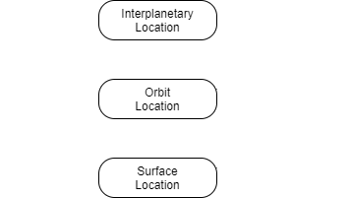
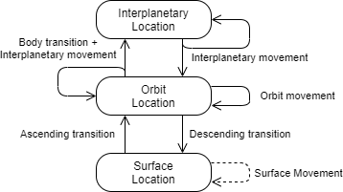
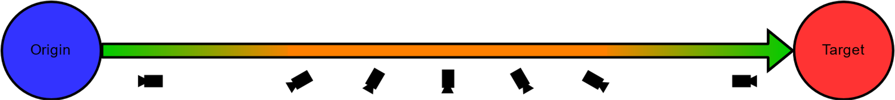
DLR.de • Chart <number>
Moritz Zeumer • 14.06.2021
How To Mitigate The Problems? - Automatic Navigation Overhaul
Separate origin and target location into general cases
  Interplanetary locations
  Orbital locations
  Surface locations
Movements and transitions between layers
  Surface, orbit, and interplanetary movements
  Ascending, descending, and body transitions
Notes:
- old nav for reference
.
(1) separate possible locations into general categories
- interplanetary → outside a body’s sphere of influence (location tracked in root frame J2000)
- orbital → inside a body’s sphere of influence (location tracked relative to body’s frame & center)
- surface → close to, or on body’s surface (- “ -)
.
(2) movements and transitions between these locations/layers
- movements on each layer (surface, orbit, interplanetary)
- transitions between layers (ascension/descension → surface ↔ orbit; body → orbit ↔ interplanetary)
- transition: movement from position from one layer to valid position in next layer layer
- interplanetary movement always ends in interp. location or valid orbital location

Slide 9
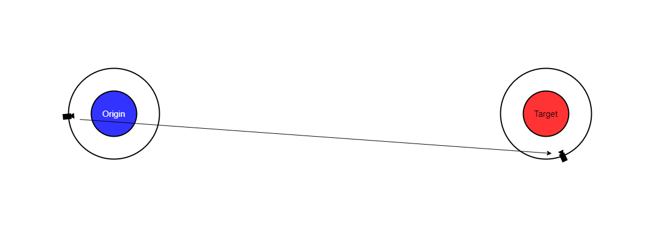
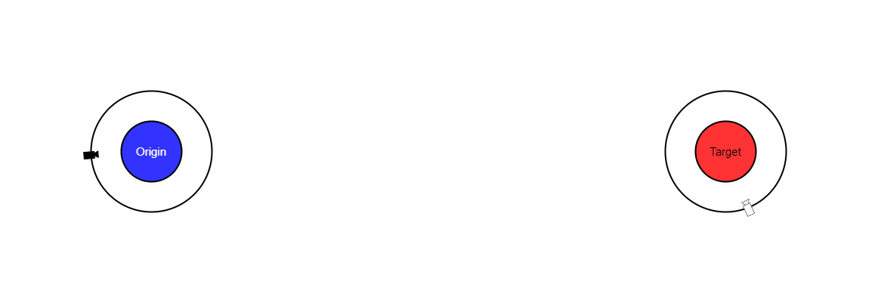
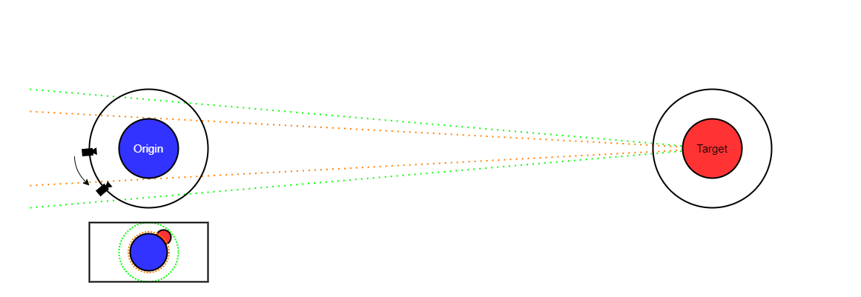
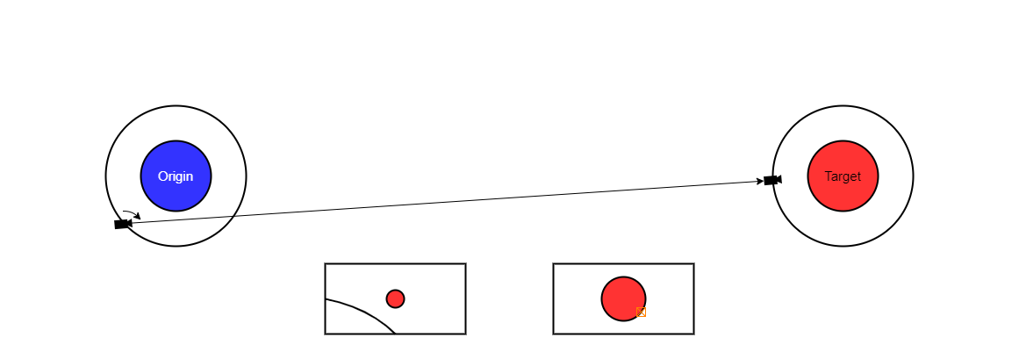
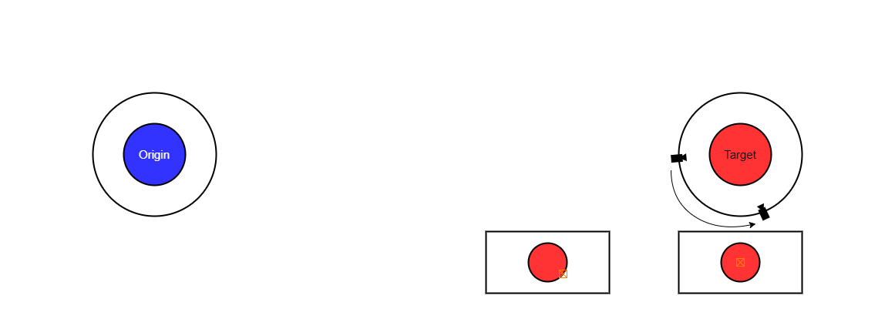
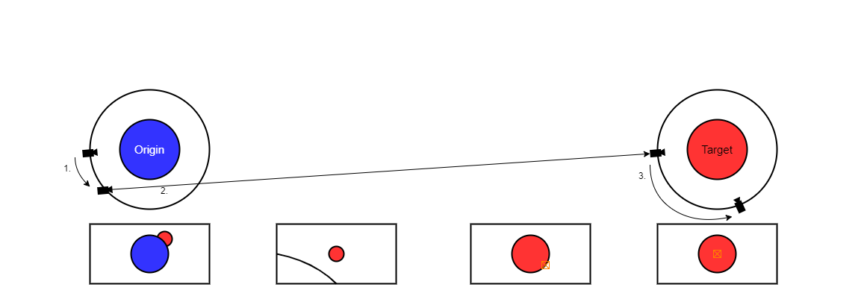
DLR.de • Chart <number>
Moritz Zeumer • 14.06.2021
How To Mitigate The Problems? - Automatic Navigation Overhaul
Notes:
(0) origin and target overview (w/ locations)
.
(1) old navigation
- linear, translation and rotation simultaneous
.
(2) body transition
- find position where origin & target are in unobstructed view based on angular constraints
.
(3) interplanetary movement
- linear movement to target orbit
- results in valid orbital position → no interp. → orbital transition
.
(4) orbit movement
- orbital movement to target location in orbit
.
(5) overview
- ascension/descension transition if necessary before/after this movement

Slide 10
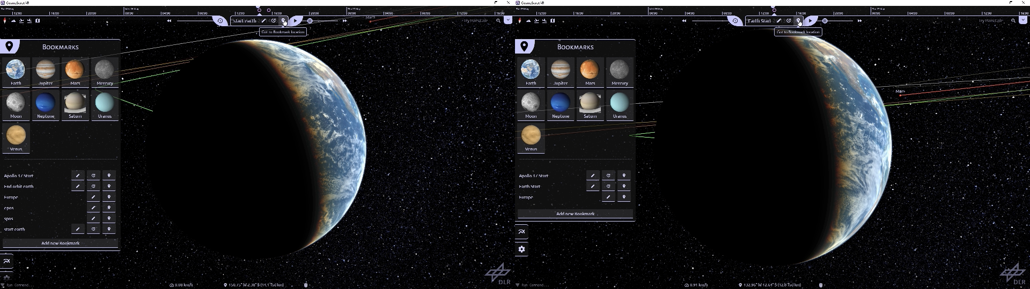
DLR.de • Chart <number>
Moritz Zeumer • 14.06.2021
How To Mitigate The Problems? - Automatic Navigation Overhaul
Orbital Movement Comparison
Video available at https://youtu.be/BOdHpa2pD1I
Notes:
(0) show comparison Orbital movement

Slide 11
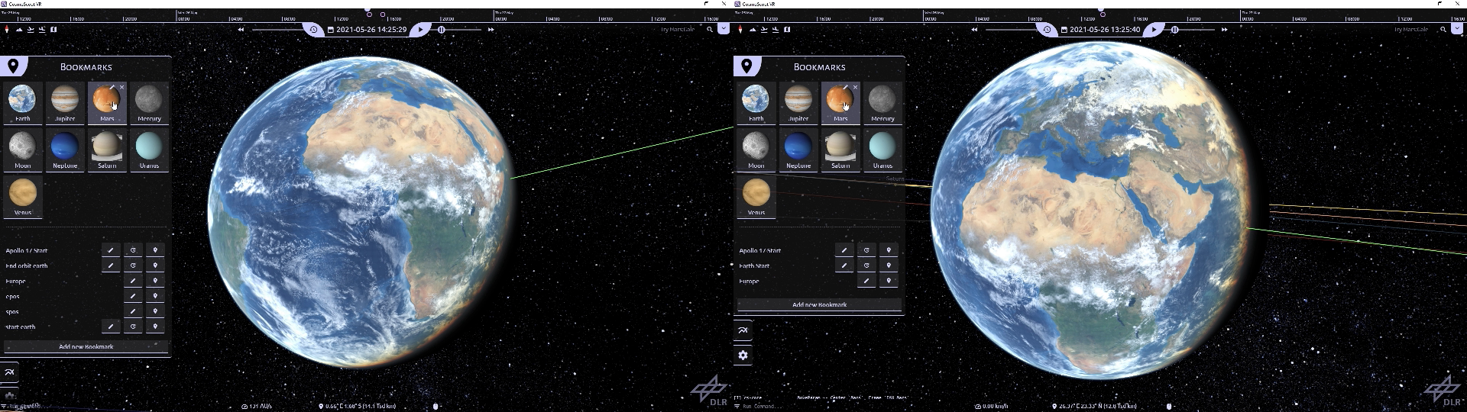
DLR.de • Chart <number>
Moritz Zeumer • 14.06.2021
How To Mitigate The Problems? - Automatic Navigation Overhaul
Interplanetary Movement Comparison
Video available at https://youtu.be/oHTQS1gfXe0
Notes:
(0) show comparison Interplanetary movement

Slide 12
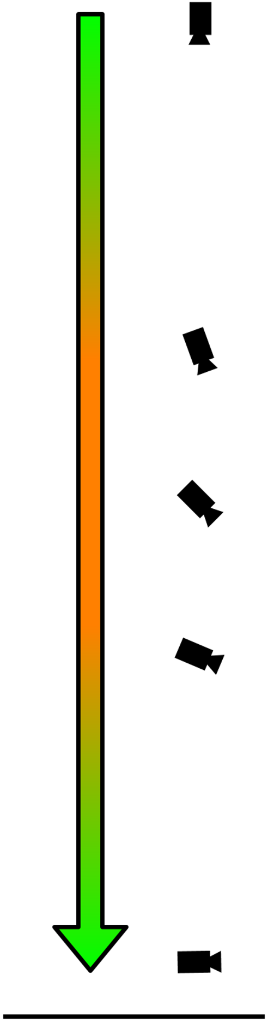
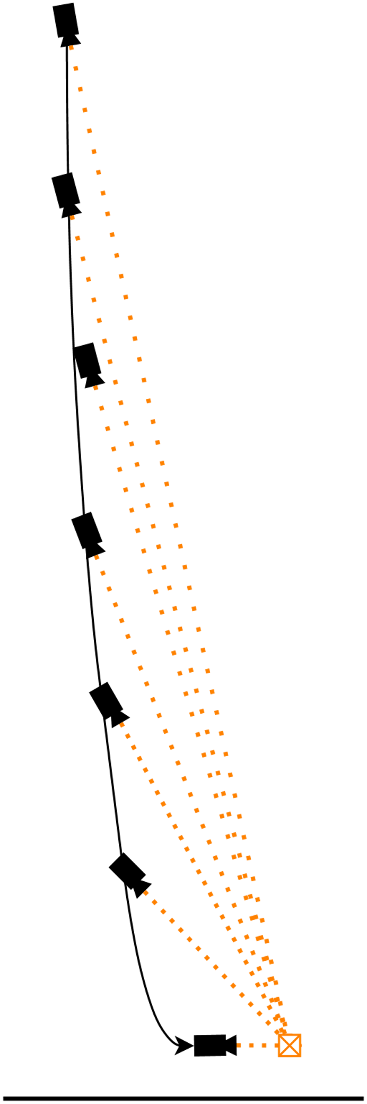
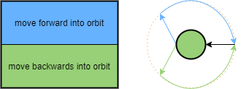
DLR.de • Chart <number>
Moritz Zeumer • 14.06.2021
How To Mitigate The Problems? - Automatic Navigation Overhaul
Travel paths moving the user forwards
  Move in orbit over and rotate towards target
  Lock view direction onto target and move along parabola curve down to target
Simple, predictable movements to mitigate sensory conflicts
Parabola movement instead of linear to "move into" target orientation
Surface movement via orbital movement
  Transition to orbit
  Move to target
  Transition back to surface
Notes:
(0) old descension tansition
- only one method → linear & simultaneous
.
(1) new transition
- move observer forward along curve
- view locked onto point in direction of final view
→ move forward into final position
.
(2) simple & predictable movements
- curve to move forward instead of sideways movement
- rotation towards the end of the movement
- similar to Google earth’s descension
.
(3) surface movement vial orbital
- ascension transition → forward/backward into orbit similar/same as descension
- orbital movement over target location
- descension transition
- offer general solution independent of distance or local topography
- extendable in future for short distances etc. (complex topic of itself)

Slide 13
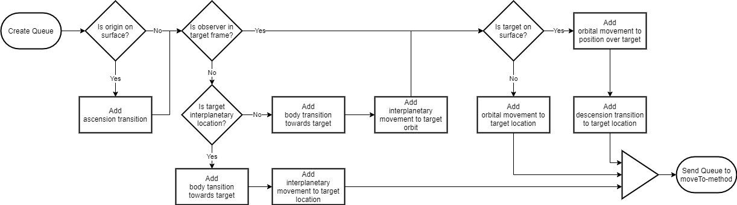
DLR.de • Chart <number>
Moritz Zeumer • 14.06.2021
How To Mitigate The Problems? - Automatic Navigation Overhaul
Parameter for elementary movements in information packages
Bundle basic movements in a queue to create complex movements
Movement queues can be constructed anywhere and passed as a bundle to the navigation system to execute
Notes:
(1) package parameters into Packages for elementary movements
- all basic movements must provide initial & final rotation, spline & point to look at during spline movement
.
(2) movement queue to allow chaining of multiple basic movements
- to create more complex movement orders
- [image] diagram how a queue is constructed based on information about the origin and target location
- i.e. if location on surface, add ascension/descension transition
.
(3) queues can be constructed anywhere
- constructed and passed instantaneous as a bundle of basic movements
- result in a complex movement path → method performs next basic movement when finished

Slide 14
DLR.de • Chart <number>
Moritz Zeumer • 14.06.2021
How To Measure the Effectiveness?
Within subjects user study to measure effectiveness of developed features
  Features tested independently
Mixture of subjective and objective measurements
  CoG measurements to record postural stability
  Fast Motion Sickness Scale (FMS) measurements to record cybersickness incidence and severity
  Questionnaires to record user feedback and satisfaction
Notes:
(1) within subject study → every subject is tested on every scenario
- measure effectiveness of developed features
- features developed to fix independent aspects (grid→ interp. free nav; vignette→ surface free nav; etc.)
- measure user satisfaction/preference for each feature
- cybersickness severity & incidence
- intuitiveness of controls with floor grid (control scheme rework)
- obstruction/limitation of view with vignette (and grid)
- predictability/easiness of movements for auto nav
~ task completion time as an assisting measurement to find problems above
.
(2) measurements for these goals both objective and subjective measurements
.
(3) Center of Gravity to measure postural stability changes between scenarios
- measure using a balance board or inertial measurement unit (IMU) of VR HMD
- objective measure to ground/anchor subjective measurements regarding cybersickness
.
(4) Fast Motion Sickness Scale for cybersickness incidence and severity
- polling subject ~every minute inside the scenario to rate cybersickness on a 20 point scale
→ generating sampled datapoints over the exposure time of each scenario
.
(5) Questionnaires to recored user feedback
- satisfaction and factors above (intuitiveness of controls, obstruction of view, easiness of movement)

Slide 15
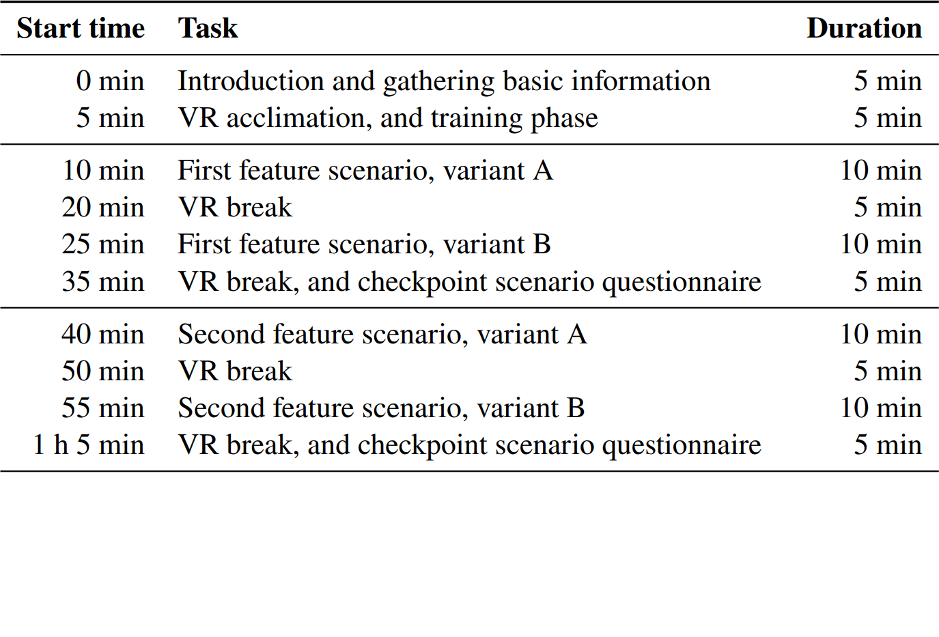
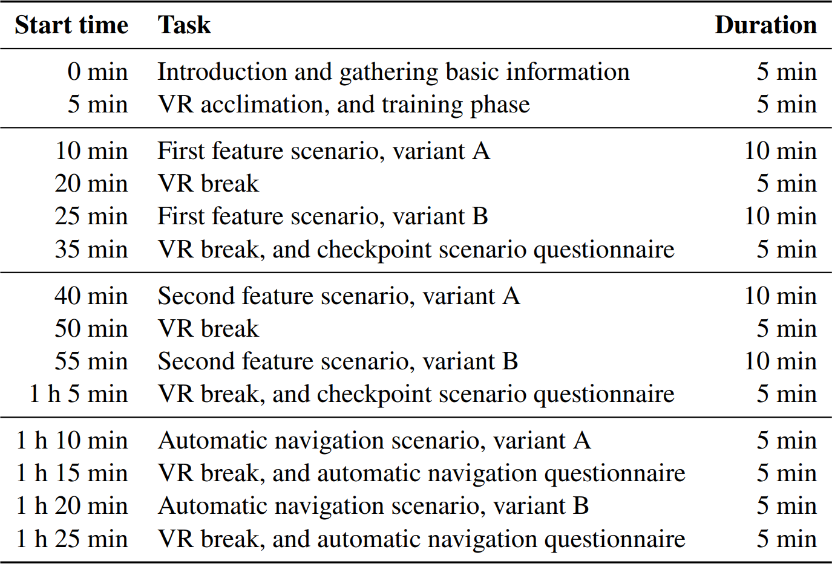
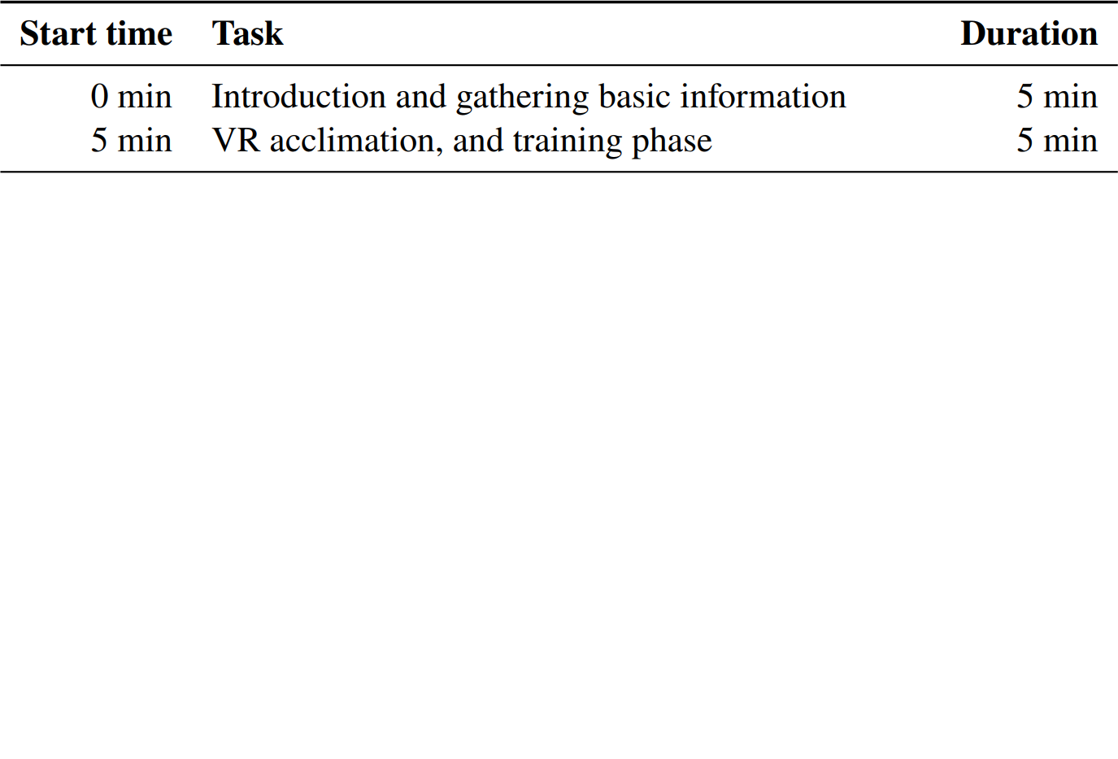
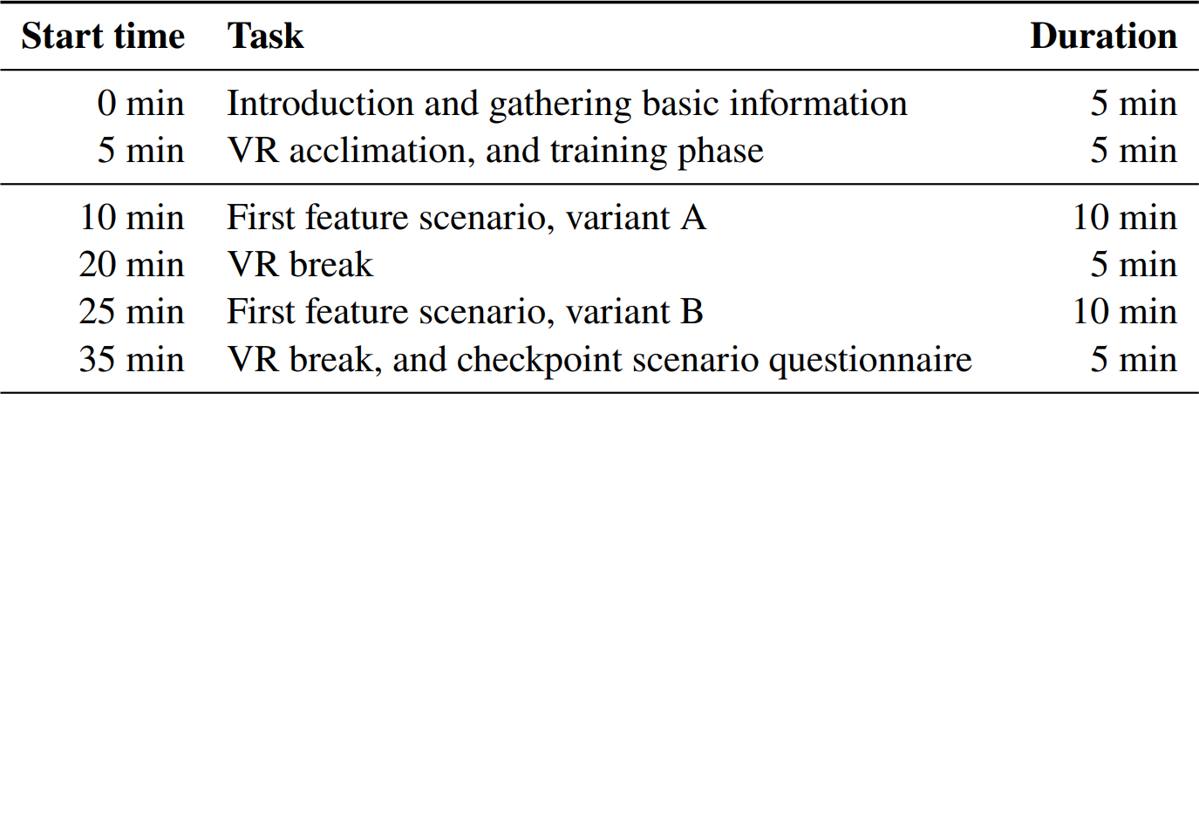
DLR.de • Chart <number>
Moritz Zeumer • 14.06.2021
How To Measure the Effectiveness? - Execution Plan
Notes:
(1) Introduction Phase
- basic info about subject (age, sex, VR experience)
- 5 min training phase to acclimate subject to VR and CosmoScout Control Scheme
.
(2) First feature phase (counterbalanced → different for each subject)
- variant A/B either with or without feature (counterbalanced)
- scenario is movement in respective area (interp. Or surface)
- 5 min breaks in between scenarios to reset to some baseline (→ best practices & sickness goes up with exposure time)
- after both scenarios questionnaire during break (preference, obscuring view, ease of use, ease of control)
.
(3) Second feature phase (counterbalanced)
- other feature tested like first feature, A/B, breaks & questionnaire
.
(4) Auto Nav Scenarios (counterbalanced)
- questionnaire during each break (satisfaction, predictability)
.
- overall ~1.5h

Slide 16
DLR.de • Chart <number>
Moritz Zeumer • 14.06.2021
How To Measure the Effectiveness? - Hypotheses
Significant results that each new feature produces less cybersickness compared to the initial situation
Significant results that subject’s acceptance or satisfaction is higher for each feature compared to the initial situation
Automatic navigation overhaul will show the most improvement
Floor grid will show the least improvement
Vignette will show less improvement than the navigation overhaul
Notes:
(1) significant results regarding cybersickness (significant difference between on/off)
.
(2) significant results that new features are better than initial situation
.
(3) auto nav will perform best
- worst symptoms in initial situation, very noticeable improvements by separation of rotation & translation
.
(4) floor grid will perform worst
- initial cybersickness in interplanetary space relatively low
- control scheme may hinder satisfaction
.
(5) vignette will perform in the middle
- independent from control scheme
- vignette is quite subject specific and default settings may be insufficient for some subject’s
- default settings should be approximated in a pre-study

Slide 17
DLR.de • Chart <number>
Moritz Zeumer • 14.06.2021
Summary & Outlook
Designed and implemented floor grid to mitigate cybersickness in interplanetary space
Designed and implemented FoV vignette to mitigate cybersickness on, or close to a body’s surface
Designed flexible and robust automatic movement system
  Implemented linear movements (for interplanetary movements)
  Implemented circular movements around a frame center (for orbital movements)
  Implemented movement queue system
  Not implemented body transition
  Not implemented ascending/descending transition (covered currently by implemented linear movement)
  Not implemented surface movement
Designed user study, but not conducted due to COVID-19 restrictions
Notes:
Overview what was done, and what wasn’t done:
.
(1) design & implementation of customisable floor grid
.
(2) design & implementation of customisable vignette
.
(3) designed the automatic movement system & implemented basic functions:
.
(4) linear movements (old movement method & interplanetary movements)
.
(5) circular arc movements (around center of frame → orbital movements)
.
(6) movement queue system for future improvements and flexible system
.
(7) not implemented body transition
- calculation of the point within the constraints → queuing orbital movement to calculated point
- (not enough time)
.
(8) not implemented asc/desc transition
- currently covered by implemented movements (orbital, but linear) resulting in linear movement with separated rotation
- focus was on orbital & interp. movement since missing mapserver & topology → hard to test, not enough time
.
(9) not implemented surface movement
- movement via orbit (no mapserver & topology, focus on orbital/interp. Movement) → not enough time
.
(10) designed userstudy, no execution, due to covid-19 & time constraints

